Slide 1
unit 1:
Data Warehousing

Slide 2
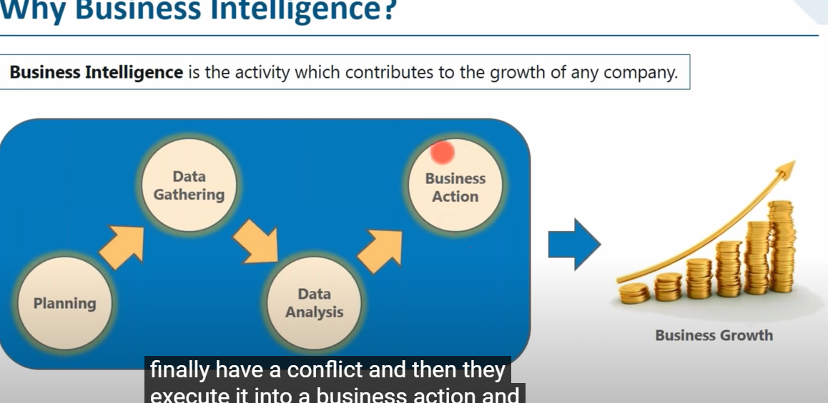
Business intelligence

Slide 3
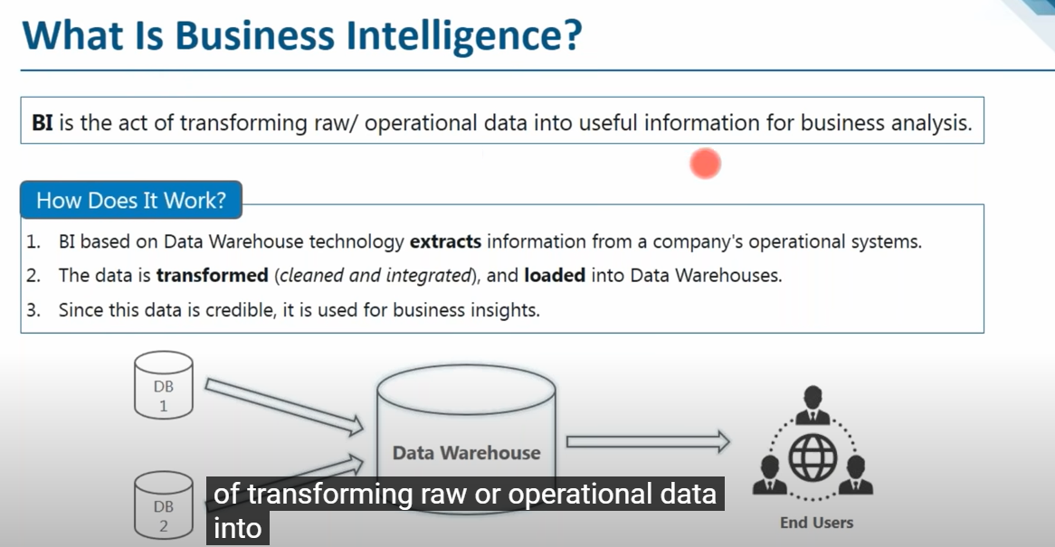
BI

Slide 4
Learning Objectives
Understand the basic definitions and concepts of data warehouses
Learn different types of data warehousing architectures; their comparative advantages and disadvantages
Describe the processes used in developing and managing data warehouses
Explain data warehousing operations
Explain the role of data warehouses in decision support

Slide 5
unit 1 -syllabus
DataWarehouse-Introduction,DataWarehouse Architecture- Multidimensional Data Model-
Data cube and OLAP Technology-Data Warehouse Implementation, Issues, Real time Data Warehousing, Data Warehouse administration, Security issues and feature trends of Data Warehouse.

Slide 6
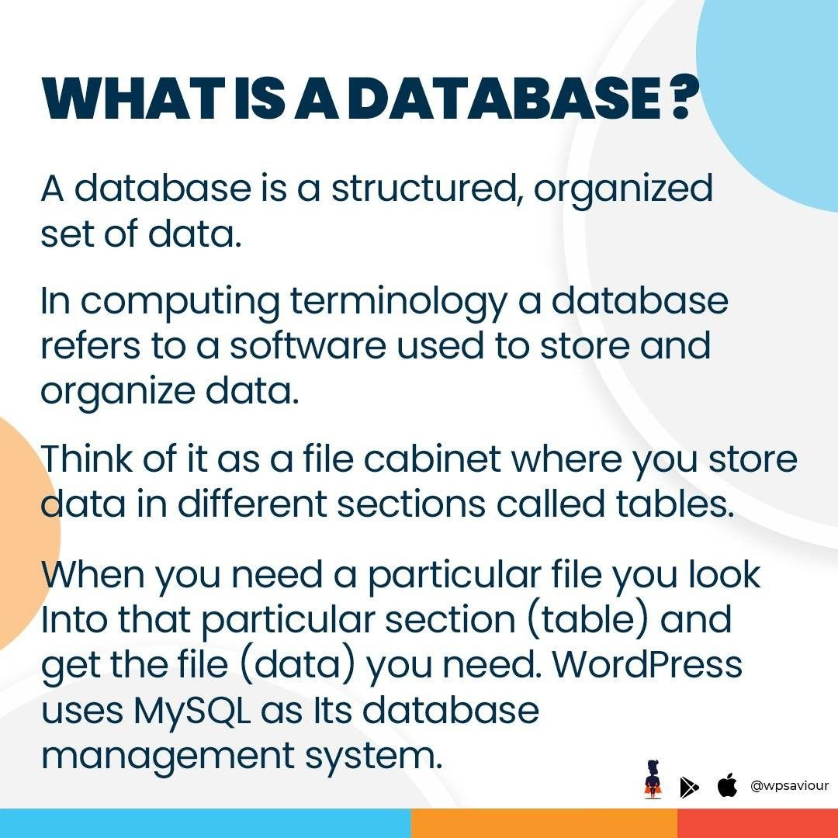
database

Slide 7
Main Data Warehousing Topics
DW definition
Characteristics of DW
Data Marts
ODS, EDW, Metadata
DW Framework
DW Architecture & ETL Process
DW Development
DW Issues

Slide 8
What is a Data Warehouse?
A physical repository where relational data are specially organized to provide enterprise-wide, cleansed data in a standardized format
“The data warehouse is a collection of integrated, subject-oriented databases designed to support DSS functions, where each unit of data is non-volatile and relevant to some moment in time”

Slide 9
DEFINATION
a data warehouse (DW or DWH), also known as an enterprise data warehouse (EDW), is a system used for reporting and data analysis and is considered a core component of business intelligence.Data warehouses are central repositories of integrated data from one or more disparate sources. They store current and historical data in one single place that are used for creating analytical reports for workers throughout the enterprise. This is beneficial for companies as it enable them to interrogate and draw insights from their data and make decisions.

Slide 10
DW
A data warehouse is an enterprise system used for the analysis and reporting of structured and semi-structured data from multiple sources, such as point-of-sale transactions, marketing automation, customer relationship management, and more. A data warehouse is suited for ad hoc analysis as well custom reporting.

Slide 11
Characteristics of DW
Subject oriented
Integrated
Time-variant (time series)
Nonvolatile
Summarized
Not normalized
Metadata
Web based, relational/multi-dimensional
Client/server
Real-time and/or right-time (active)

Slide 12
Ware house
What is warehouse?
A warehouse is a building for storing goods. Warehouses are used by manufacturers, importers, exporters, wholesalers, transport businesses, customs, etc. They are usually large plain buildings in industrial parks on the outskirts of cities, towns, or villages

Slide 13

dw

Slide 14
Types
Two types datawarehousing
1.history of data
2.current data
Ex:bank statements
1.6 months data
2.current data

Slide 15
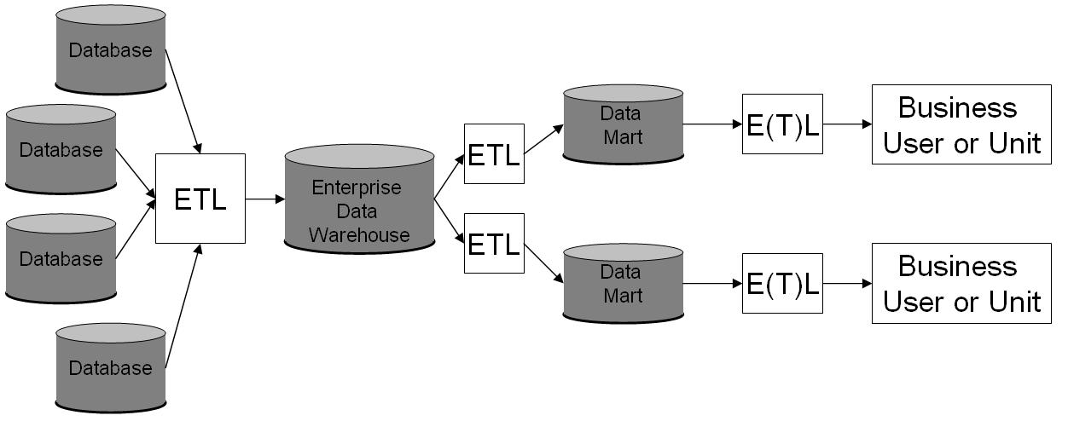
Overview DATAWAREHOUSING

Slide 16
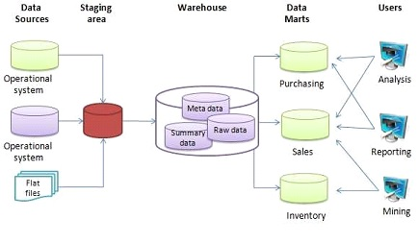
DW Architecture

Slide 17
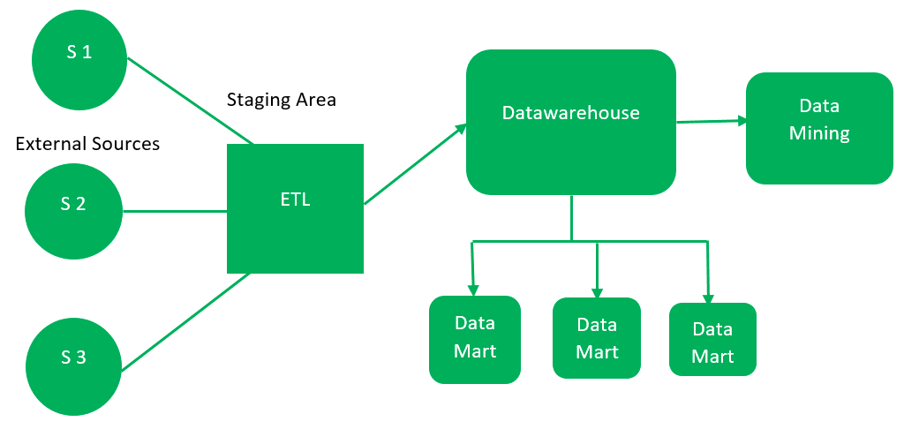
A data-warehouse is a heterogeneous collection of different data sources organized under a unified schema. There are 2 approaches for constructing data-warehouse: Top-down approach and Bottom-up approach are explained as below.
1. Top-down approach:

Slide 18
Top-Down Approach
External Sources – External source is a source from where data is collected irrespective of the type of data. Data can be structured, semi structured and unstructured as well. Stage Area – Since the data, extracted from the external sources does not follow a particular format, so there is a need to validate this data to load into data warehouse. For this purpose, it is recommended to use ETL tool.
E(Extracted): Data is extracted from External data source.
T(Transform): Data is transformed into the standard format.
L(Load): Data is loaded into data warehouse after transforming it into the standard format.
Data-warehouse – After cleansing of data, it is stored in the data warehouse as central repository. It actually stores the meta data and the actual data gets stored in the data marts. Note that data warehouse stores the data in its purest form in this top-down approach. Data Marts – Data mart is also a part of storage component. It stores the information of a particular function of an organization which is handled by single authority. There can be as many number of data marts in an organization depending upon the functions. We can also say that data mart contains subset of the data stored in datawarehouse. Data Mining – The practice of analyzing the big data present in datawarehouse is data mining. It is used to find the hidden patterns that are present in the database or in datawarehouse with the help of algorithm of data mining. This approach is defined by Inmon as – datawarehouse as a central repository for the complete organization and data marts are created from it after the complete datawarehouse has been created.

Slide 19
Advantages of Top-Down Approach –
Since the data marts are created from the data warehouse, provides consistent dimensional view of data marts.
Also, this model is considered as the strongest model for business changes. That’s why, big organizations prefer to follow this approach.
Creating data mart from data warehouse is easy.
Improved data consistency: The top-down approach promotes data consistency by ensuring that all data marts are sourced from a common data warehouse. This ensures that all data is standardized, reducing the risk of errors and inconsistencies in reporting.
Easier maintenance: Since all data marts are sourced from a central data warehouse, it is easier to maintain and update the data in a top-down approach. Changes can be made to the data warehouse, and those changes will automatically propagate to all the data marts that rely on it.
Better scalability: The top-down approach is highly scalable, allowing organizations to add new data marts as needed without disrupting the existing infrastructure. This is particularly important for organizations that are experiencing rapid growth or have evolving business needs.
Improved governance: The top-down approach facilitates better governance by enabling centralized control of data access, security, and quality. This ensures that all data is managed consistently and that it meets the organization’s standards for quality and compliance.
Reduced duplication: The top-down approach reduces data duplication by ensuring that data is stored only once in the data warehouse. This saves storage space and reduces the risk of data inconsistencies.
Better reporting: The top-down approach enables better reporting by providing a consistent view of data across all data marts. This makes it easier to create accurate and timely reports, which can improve decision-making and drive better business outcomes.
Better data integration: The top-down approach enables better data integration by ensuring that all data marts are sourced from a common data warehouse. This makes it easier to integrate data from different sources and provides a more complete view of the organization’s data.

Slide 20
Disadvantages of Top-Down Approach
The cost, time taken in designing and its maintenance is very high.
Complexity: The top-down approach can be complex to implement and maintain, particularly for large organizations with complex data needs. The design and implementation of the data warehouse and data marts can be time-consuming and costly.
Lack of flexibility: The top-down approach may not be suitable for organizations that require a high degree of flexibility in their data reporting and analysis. Since the design of the data warehouse and data marts is pre-determined, it may not be possible to adapt to new or changing business requirements.
Limited user involvement: The top-down approach can be dominated by IT departments, which may lead to limited user involvement in the design and implementation process. This can result in data marts that do not meet the specific needs of business users.
Data latency: The top-down approach may result in data latency, particularly when data is sourced from multiple systems. This can impact the accuracy and timeliness of reporting and analysis.
Data ownership: The top-down approach can create challenges around data ownership and control. Since data is centralized in the data warehouse, it may not be clear who is responsible for maintaining and updating the data.
Cost: The top-down approach can be expensive to implement and maintain, particularly for smaller organizations that may not have the resources to invest in a large-scale data warehouse and associated data marts.
Integration challenges: The top-down approach may face challenges in integrating data from different sources, particularly when data is stored in different formats or structures. This can lead to data inconsistencies and inaccuracies.

Slide 21
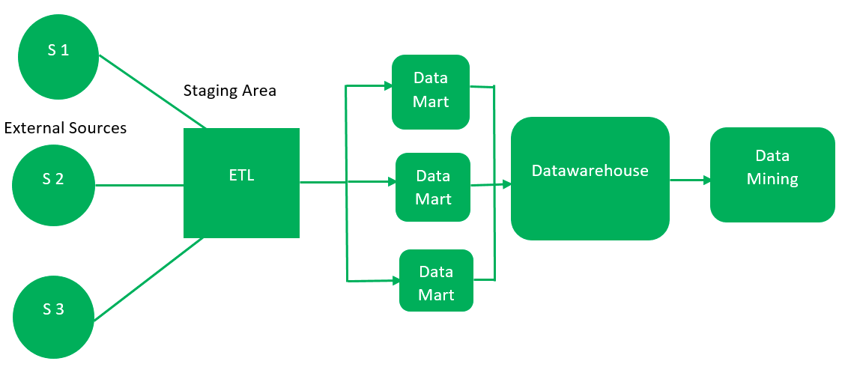
Bottom-up approach:

Slide 22
DW
First, the data is extracted from external sources (same as happens in top-down approach).
Then, the data go through the staging area (as explained above) and loaded into data marts instead of datawarehouse. The data marts are created first and provide reporting capability. It addresses a single business area.
These data marts are then integrated into datawarehouse.
This approach is given by Kinball as – data marts are created first and provides a thin view for analyses and datawarehouse is created after complete data marts have been created.

Slide 23
Advantages of Bottom-Up Approach –
As the data marts are created first, so the reports are quickly generated.
We can accommodate more number of data marts here and in this way data warehouse can be extended.
Also, the cost and time taken in designing this model is low comparatively.
Incremental development: The bottom-up approach supports incremental development, allowing for the creation of data marts one at a time. This allows for quick wins and incremental improvements in data reporting and analysis.
User involvement: The bottom-up approach encourages user involvement in the design and implementation process. Business users can provide feedback on the data marts and reports, helping to ensure that the data marts meet their specific needs.
Flexibility: The bottom-up approach is more flexible than the top-down approach, as it allows for the creation of data marts based on specific business needs. This approach can be particularly useful for organizations that require a high degree of flexibility in their reporting and analysis.
Faster time to value: The bottom-up approach can deliver faster time to value, as the data marts can be created more quickly than a centralized data warehouse. This can be particularly useful for smaller organizations with limited resources.
Reduced risk: The bottom-up approach reduces the risk of failure, as data marts can be tested and refined before being incorporated into a larger data warehouse. This approach can also help to identify and address potential data quality issues early in the process.
Scalability: The bottom-up approach can be scaled up over time, as new data marts can be added as needed. This approach can be particularly useful for organizations that are growing rapidly or undergoing significant change.
Data ownership: The bottom-up approach can help to clarify data ownership and control, as each data mart is typically owned and managed by a specific business unit. This can help to ensure that data is accurate and up-to-date, and that it is being used in a consistent and appropriate way across the organization.

Slide 24
Disadvantage of Bottom-Up Approach –
This model is not strong as top-down approach as dimensional view of data marts is not consistent as it is in above approach.
Data silos: The bottom-up approach can lead to the creation of data silos, where different business units create their own data marts without considering the needs of other parts of the organization. This can lead to inconsistencies and redundancies in the data, as well as difficulties in integrating data across the organization.
Integration challenges: Because the bottom-up approach relies on the integration of multiple data marts, it can be more difficult to integrate data from different sources and ensure consistency across the organization. This can lead to issues with data quality and accuracy.
Duplication of effort: In a bottom-up approach, different business units may duplicate effort by creating their own data marts with similar or overlapping data. This can lead to inefficiencies and higher costs in data management.
Lack of enterprise-wide view: The bottom-up approach can result in a lack of enterprise-wide view, as data marts are typically designed to meet the needs of specific business units rather than the organization as a whole. This can make it difficult to gain a comprehensive understanding of the organization’s data and business processes.
Complexity: The bottom-up approach can be more complex than the top-down approach, as it involves the integration of multiple data marts with varying levels of complexity and granularity. This can make it more difficult to manage and maintain the data warehouse over time.
Risk of inconsistency: Because the bottom-up approach allows for the creation of data marts with different structures and granularities, there is a risk of inconsistency in the data. This can make it difficult to compare data across different parts of the organization or to ensure that reports are accurate and reliable.

Slide 25
TYPES OF dw
Three-tier architecture
Data acquisition software (back-end)
The data warehouse that contains the data & software
Client (front-end) software that allows users to access and analyze data from the warehouse
Two-tier architecture
First 2 tiers in three-tier architecture is combined into one
Sometimes there is only one tier

Slide 26
TWO TIER

Slide 27
THREE TIER

Slide 28
Four tier

Slide 29
What is Data Mart?
A Data Mart is a subset of a directorial information store, generally oriented to a specific purpose or primary data subject which may be distributed to provide business needs. Data Marts are analytical record stores designed to focus on particular business functions for a specific community within an organization. Data marts are derived from subsets of data in a data warehouse, though in the bottom-up data warehouse design methodology, the data warehouse is created from the union of organizational data marts.

Slide 30
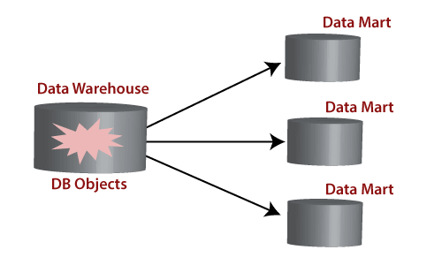
Data mart

Slide 31
Creates collective data by a group of users
Easy access to frequently needed data
Ease of creation
Improves end-user response time
Lower cost than implementing a complete data warehouses
Potential clients are more clearly defined than in a comprehensive data warehouse
It contains only essential business data and is less cluttered.

Slide 32
Types of Data Marts
There are mainly two approaches to designing data marts. These approaches are
Dependent Data Marts
Independent Data Marts

Slide 33
Dependent Data Marts
A dependent data marts is a logical subset of a physical subset of a higher data warehouse. According to this technique, the data marts are treated as the subsets of a data warehouse. In this technique, firstly a data warehouse is created from which further various data marts can be created. These data mart are dependent on the data warehouse and extract the essential record from it. In this technique, as the data warehouse creates the data mart; therefore, there is no need for data mart integration. It is also known as a top-down approach.

Slide 34
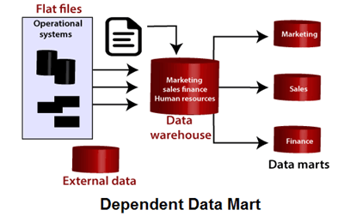

Slide 35
Independent Data Marts
Independent Data Marts
The second approach is Independent data marts (IDM) Here, firstly independent data marts are created, and then a data warehouse is designed using these independent multiple data marts. In this approach, as all the data marts are designed independently; therefore, the integration of data marts is required. It is also termed as a bottom-up approach as the data marts are integrated to develop a data warehouse.
What is Data Mart?

Slide 36
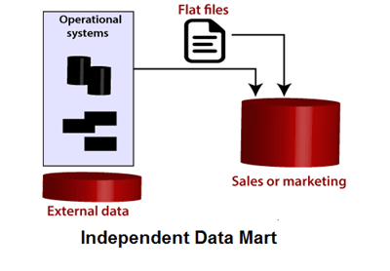

Slide 37
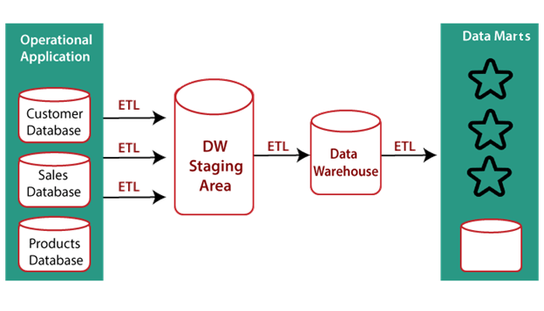

Slide 38
Multidimensional Data Model
The multi-Dimensional Data Model is a method which is used for ordering data in the database along with good arrangement and assembling of the contents in the database.
The Multi Dimensional Data Model allows customers to interrogate analytical questions associated with market or business trends, unlike relational databases which allow customers to access data in the form of queries. They allow users to rapidly receive answers to the requests which they made by creating and examining the data comparatively fast.
OLAP (online analytical processing) and data warehousing uses multi dimensional databases. It is used to show multiple dimensions of the data to users.
It represents data in the form of data cubes. Data cubes allow to model and view the data from many dimensions and perspectives. It is defined by dimensions and facts and is represented by a fact table. Facts are numerical measures and fact tables contain measures of the related dimensional tables or names of the facts

Slide 39
Features of multidimensional data models:
Measures: Measures are numerical data that can be analyzed and compared, such as sales or revenue. They are typically stored in fact tables in a multidimensional data model.
Dimensions: Dimensions are attributes that describe the measures, such as time, location, or product. They are typically stored in dimension tables in a multidimensional data model.
Cubes: Cubes are structures that represent the multidimensional relationships between measures and dimensions in a data model. They provide a fast and efficient way to retrieve and analyze data.
Aggregation: Aggregation is the process of summarizing data across dimensions and levels of detail. This is a key feature of multidimensional data models, as it enables users to quickly analyze data at different levels of granularity.
Drill-down and roll-up: Drill-down is the process of moving from a higher-level summary of data to a lower level of detail, while roll-up is the opposite process of moving from a lower-level detail to a higher-level summary. These features enable users to explore data in greater detail and gain insights into the underlying patterns.
Hierarchies: Hierarchies are a way of organizing dimensions into levels of detail. For example, a time dimension might be organized into years, quarters, months, and days. Hierarchies provide a way to navigate the data and perform drill-down and roll-up operations.
OLAP (Online Analytical Processing): OLAP is a type of multidimensional data model that supports fast and efficient querying of large datasets. OLAP systems are designed to handle complex queries and provide fast response times.

Slide 40
Working on a Multidimensional Data Model
Stage 1 : Assembling data from the client : In first stage, a Multi Dimensional Data Model collects correct data from the client. Mostly, software professionals provide simplicity to the client about the range of data which can be gained with the selected technology and collect the complete data in detail.
Stage 2 : Grouping different segments of the system : In the second stage, the Multi Dimensional Data Model recognizes and classifies all the data to the respective section they belong to and also builds it problem-free to apply step by step.
Stage 3 : Noticing the different proportions : In the third stage, it is the basis on which the design of the system is based. In this stage, the main factors are recognized according to the user’s point of view. These factors are also known as “Dimensions”.
Stage 4 : Preparing the actual-time factors and their respective qualities : In the fourth stage, the factors which are recognized in the previous step are used further for identifying the related qualities. These qualities are also known as “attributes” in the database.
Stage 5 : Finding the actuality of factors which are listed previously and their qualities : In the fifth stage, A Multi Dimensional Data Model separates and differentiates the actuality from the factors which are collected by it. These actually play a significant role in the arrangement of a Multi Dimensional Data Model.
Stage 6 : Building the Schema to place the data, with respect to the information collected from the steps above : In the sixth stage, on the basis of the data which was collected previously, a Schema is built.

Slide 41
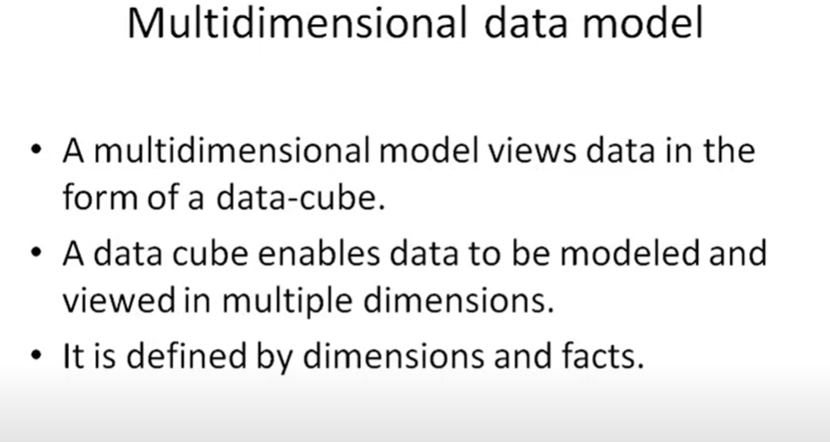
Multidimensional data

Slide 42
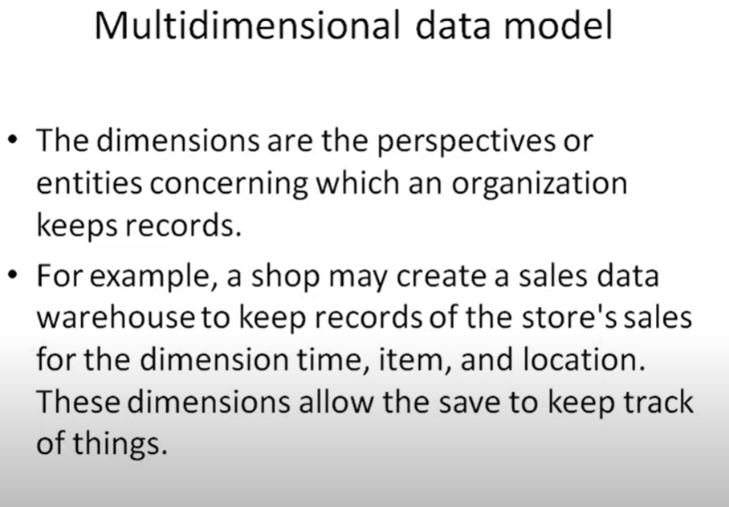
EXAMPLE

Slide 43
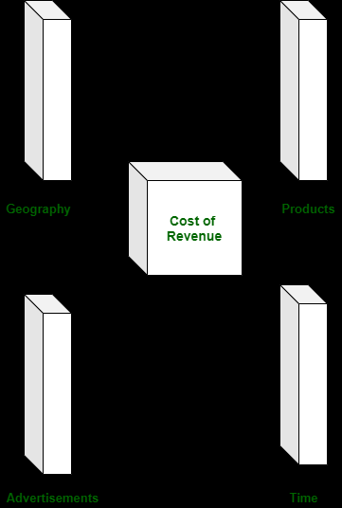
For Example :
1. Let us take the example of a firm. The revenue cost of a firm can be recognized on the basis of different factors such as geographical location of firm’s workplace, products of the firm, advertisements done, time utilized to flourish a product, etc.

Slide 44
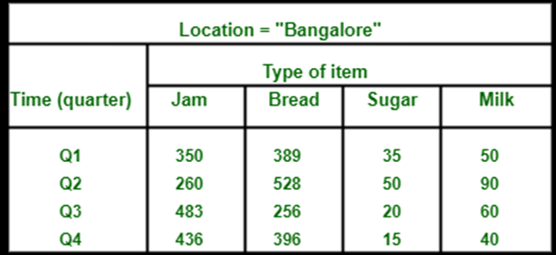
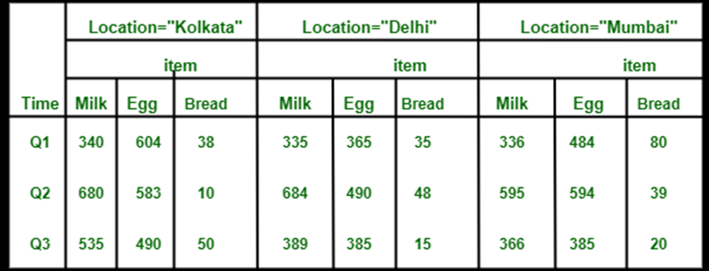
if we desire to view the data of the sales in a three-dimensional table, then it is represented in the diagram given below. Here the data of the sales is represented as a two dimensional table. Let us consider the data according to item, time and location (like Kolkata, Delhi, Mumbai). Here is the table :

Slide 45
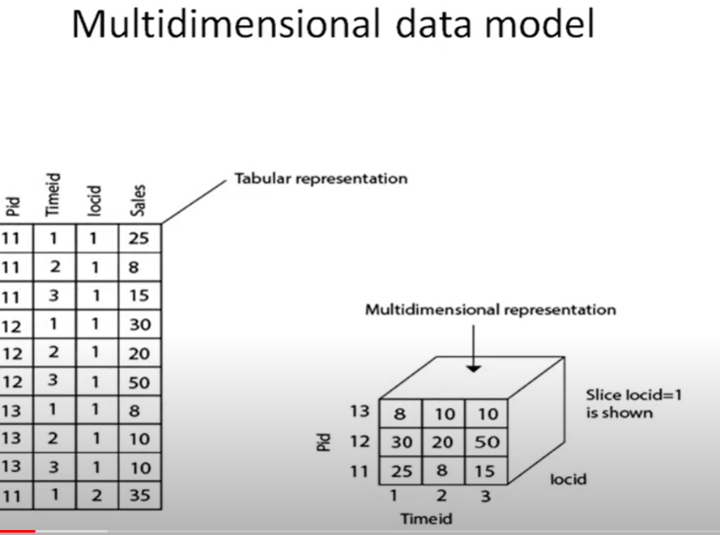
REPRESENTATION

Slide 46
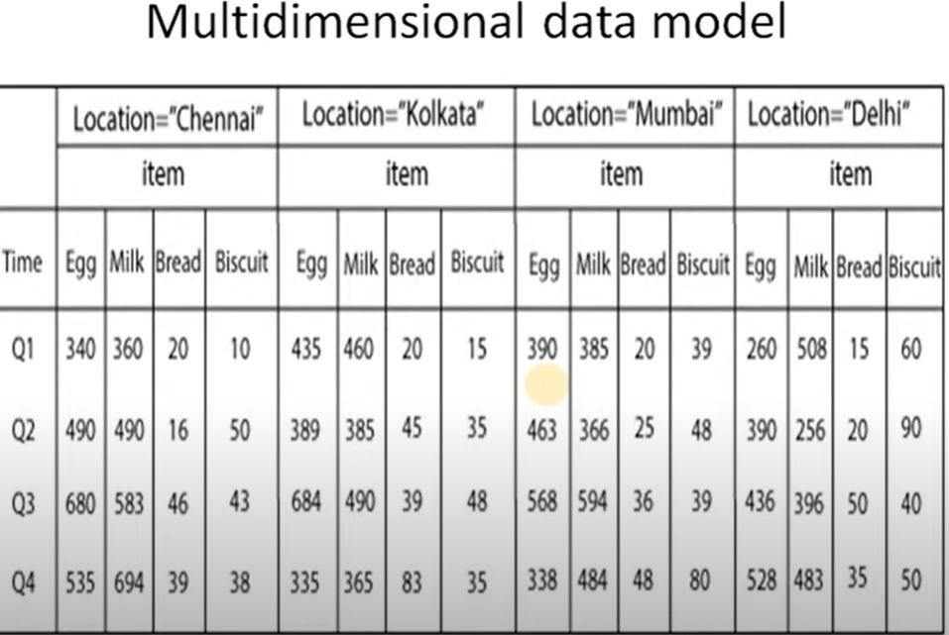
EX

Slide 47
Advantages of Multi Dimensional Data Model
The following are the advantages of a multi-dimensional data model :
A multi-dimensional data model is easy to handle.
It is easy to maintain.
Its performance is better than that of normal databases (e.g. relational databases).
The representation of data is better than traditional databases. That is because the multi-dimensional databases are multi-viewed and carry different types of factors.
It is workable on complex systems and applications, contrary to the simple one-dimensional database systems.
The compatibility in this type of database is an upliftment for projects having lower bandwidth for maintenance staff.
Disadvantages of Multi Dimensional Data Model
The following are the disadvantages of a Multi Dimensional Data Model :
The multi-dimensional Data Model is slightly complicated in nature and it requires professionals to recognize and examine the data in the database.
During the work of a Multi-Dimensional Data Model, when the system caches, there is a great effect on the working of the system.
It is complicated in nature due to which the databases are generally dynamic in design.
The path to achieving the end product is complicated most of the time.
As the Multi Dimensional Data Model has complicated systems, databases have a large number of databases due to which the system is very insecure when there is a security break.

Slide 48
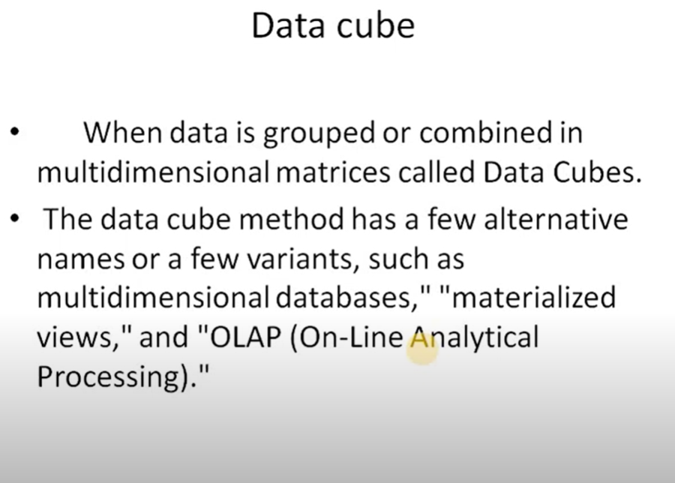
Data cube

Slide 49
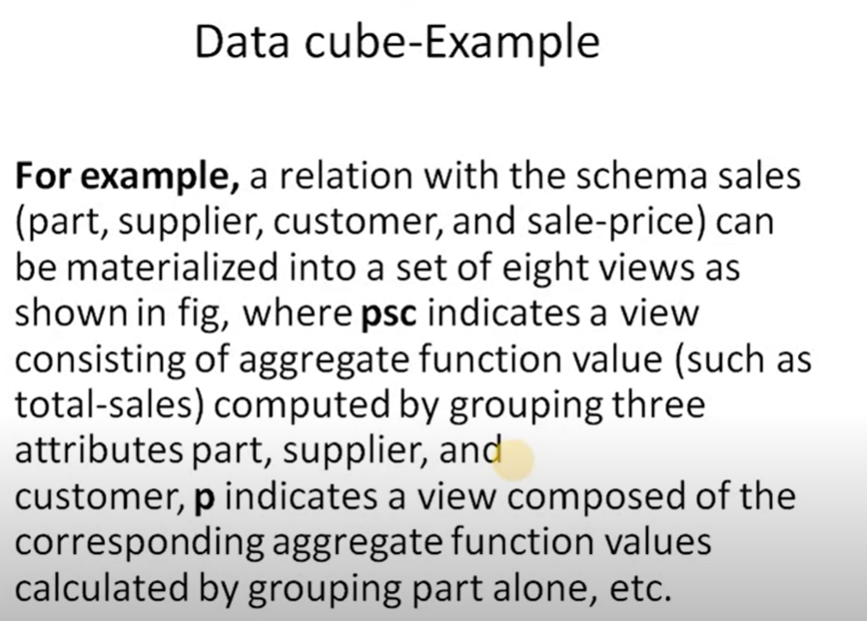
EXAMPLE

Slide 50
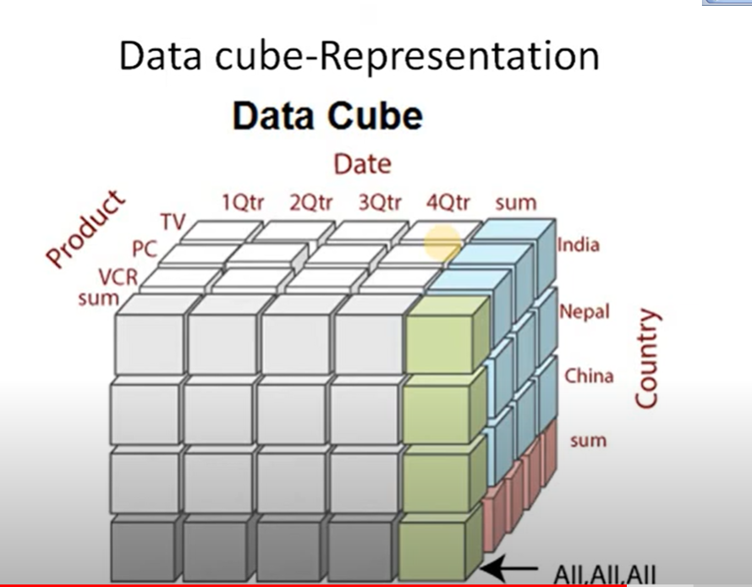
DATA CUBE

Slide 51
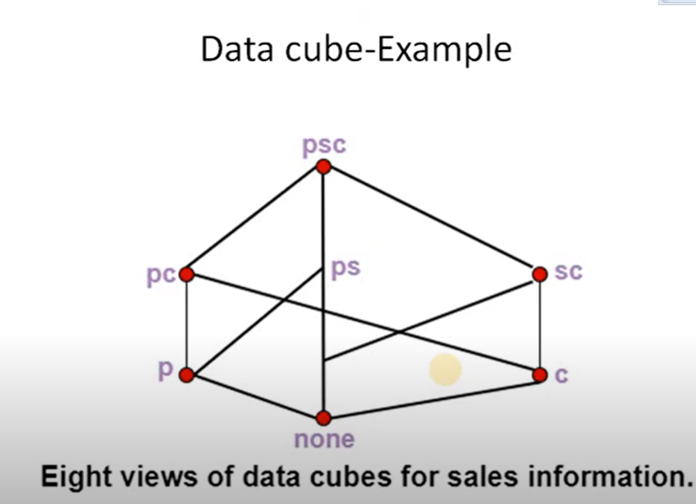

Slide 52
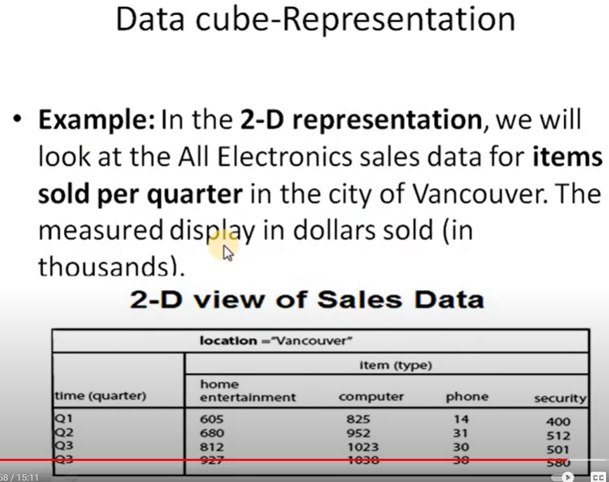
TYPES OF DATACUBES

Slide 53
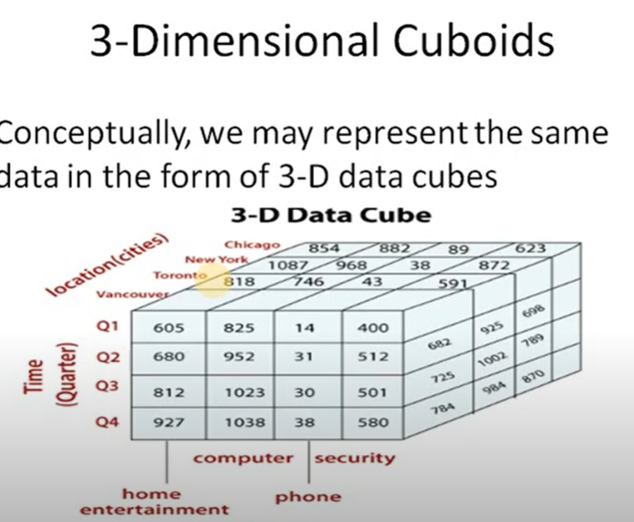

Slide 54
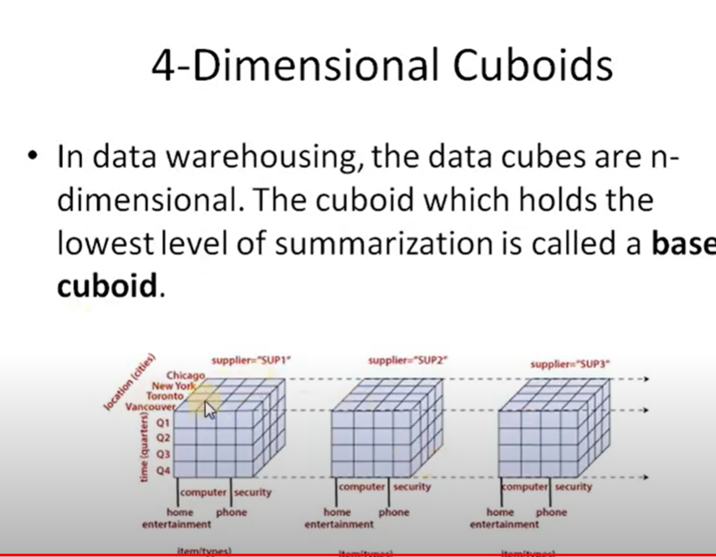

Slide 55
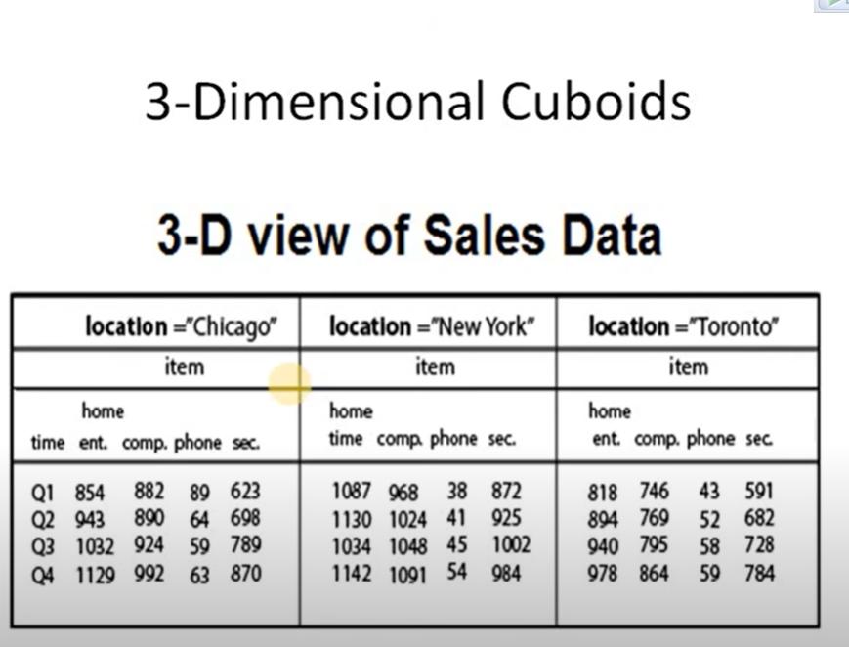
3D

Slide 56
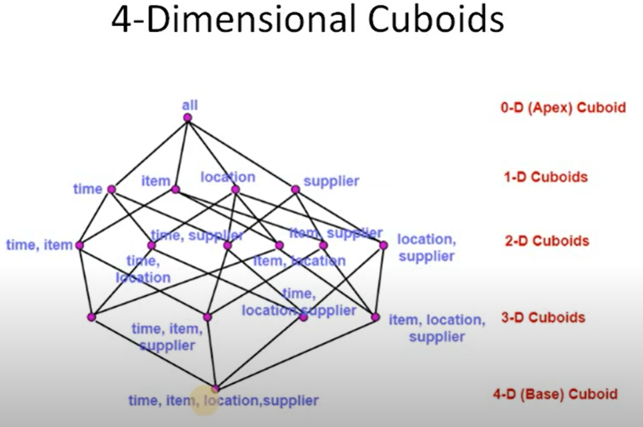

Slide 57
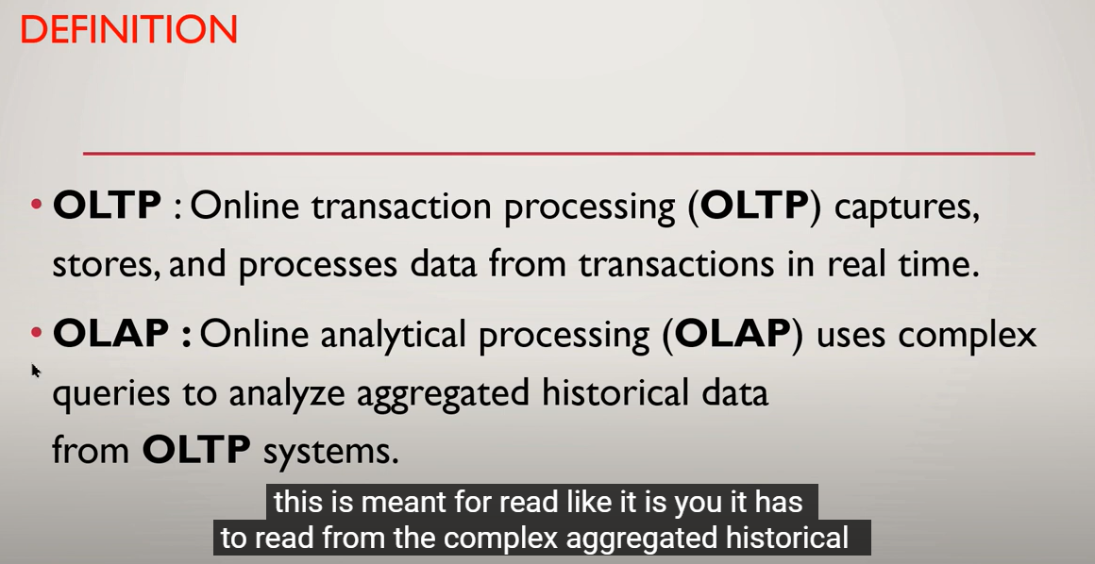
OLAP-OLTP

Slide 58
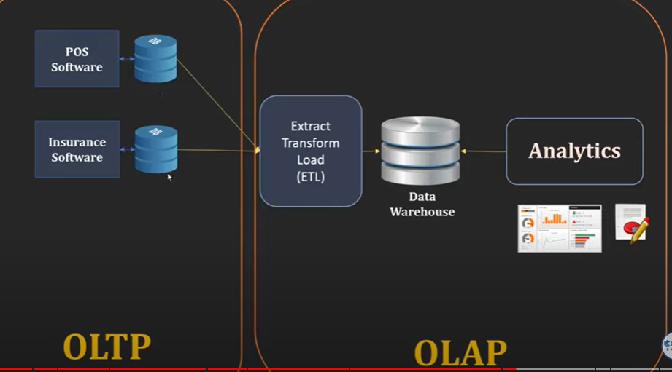
Oltp /olap

Slide 59
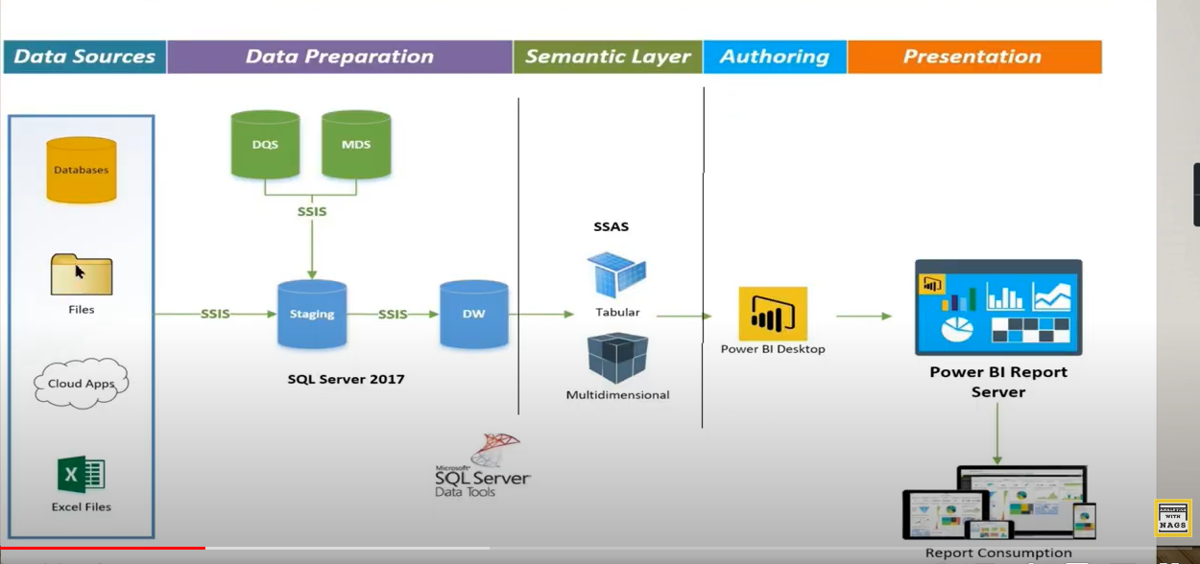

Slide 60
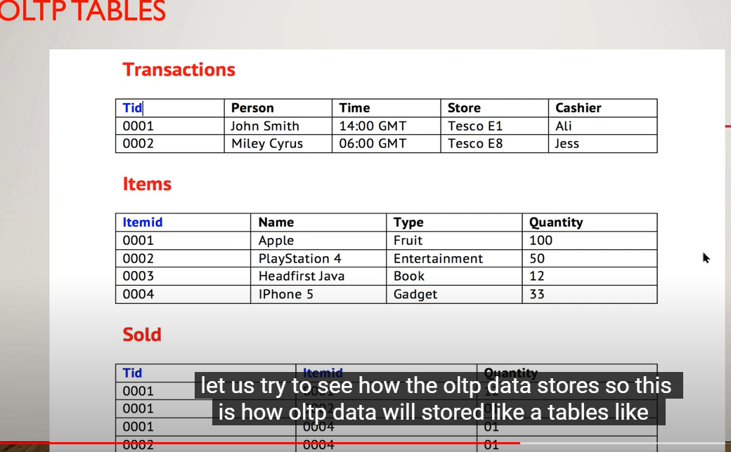
OLTP

Slide 61
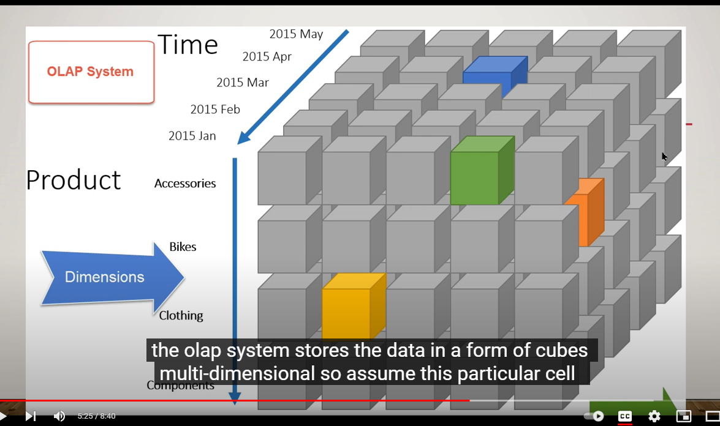
olap

Slide 62
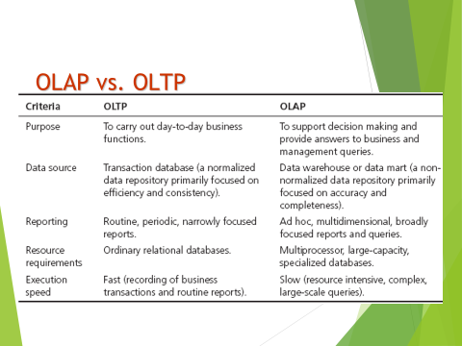

Slide 63
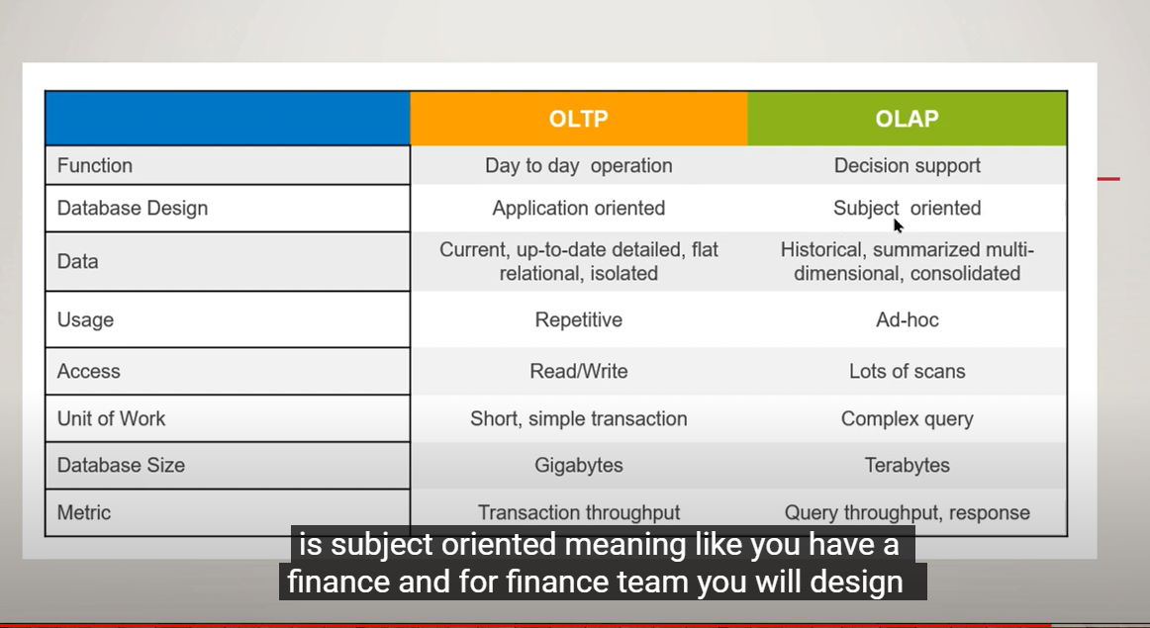

Slide 64
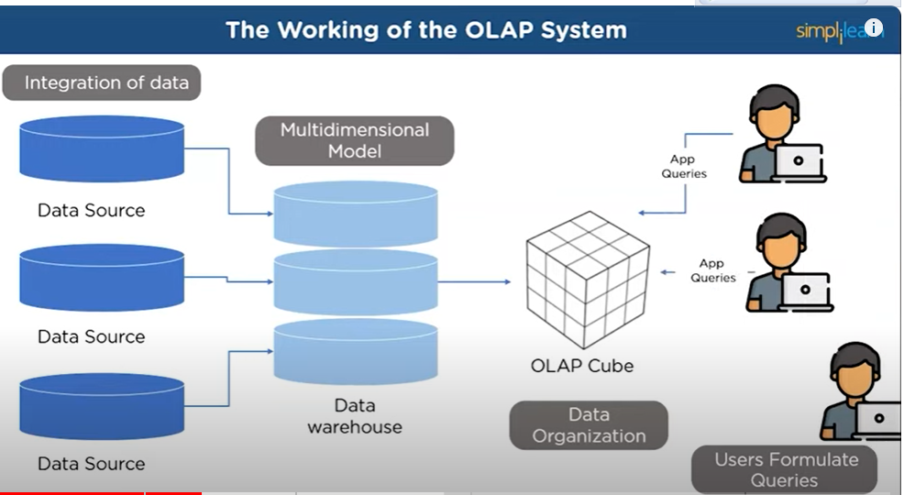
OLAP

Slide 65
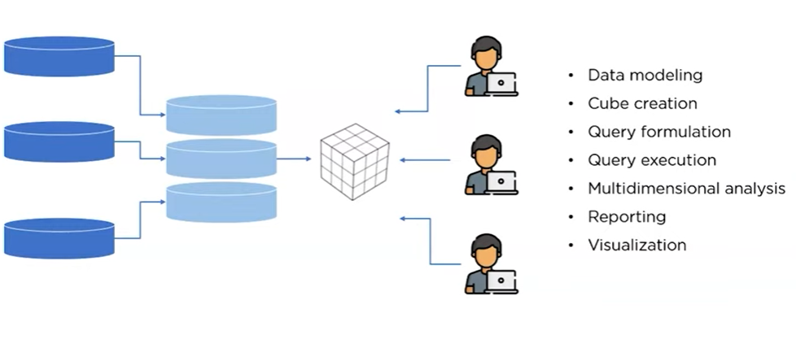

Slide 66
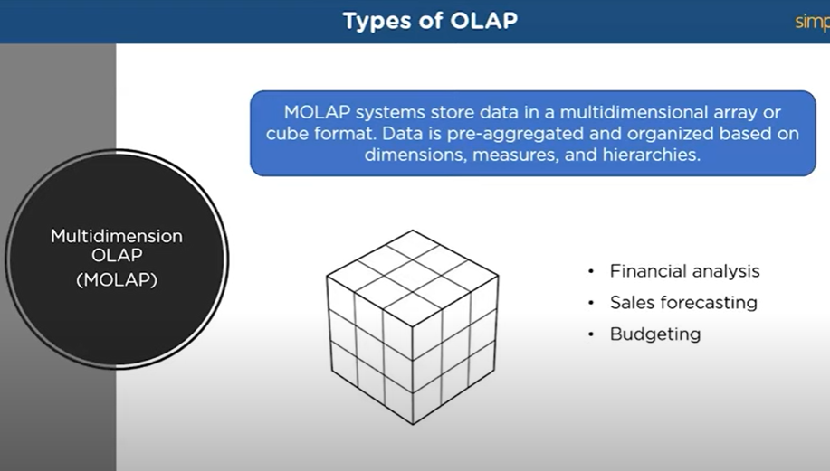

Slide 67
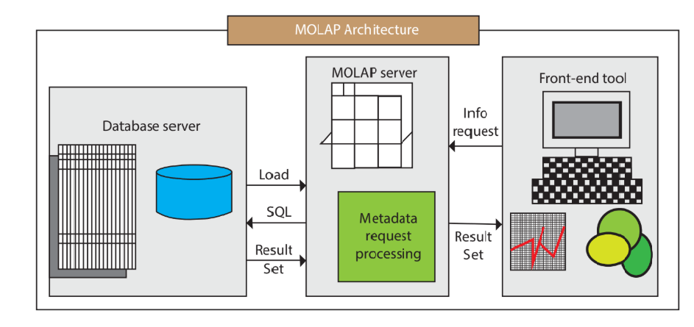

Slide 68
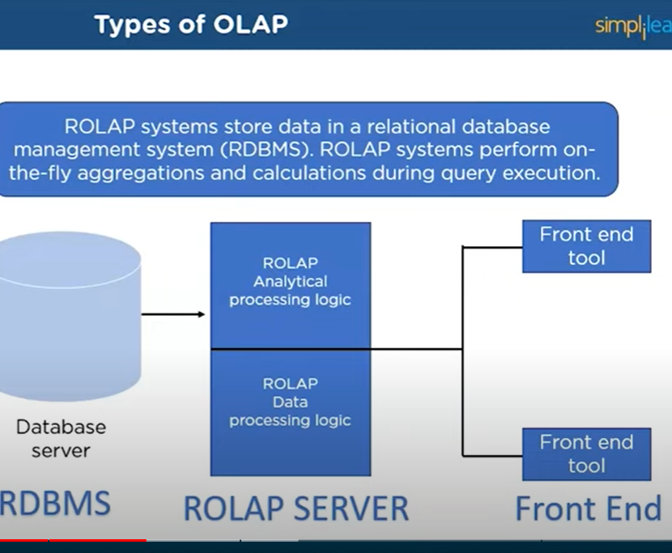
olap

Slide 69
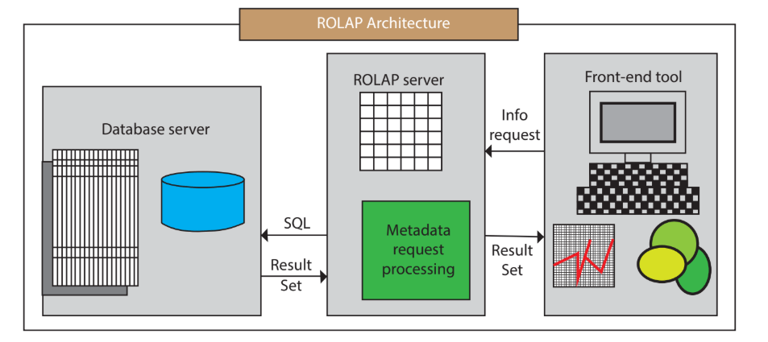

Slide 70
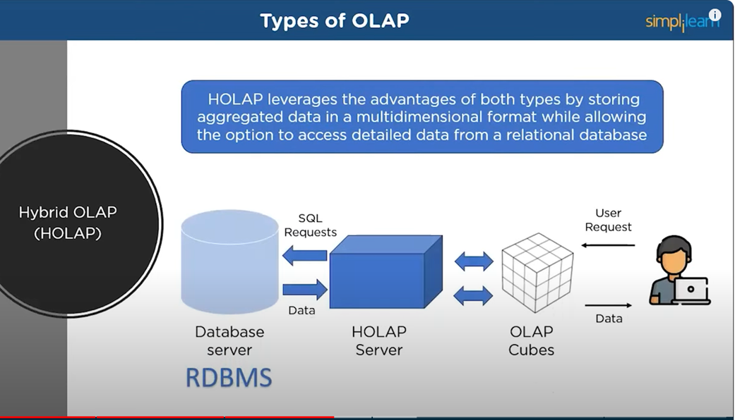
HOLAP

Slide 71
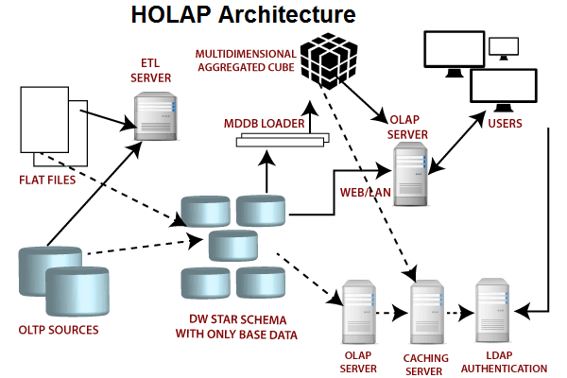
HOLAP

Slide 72
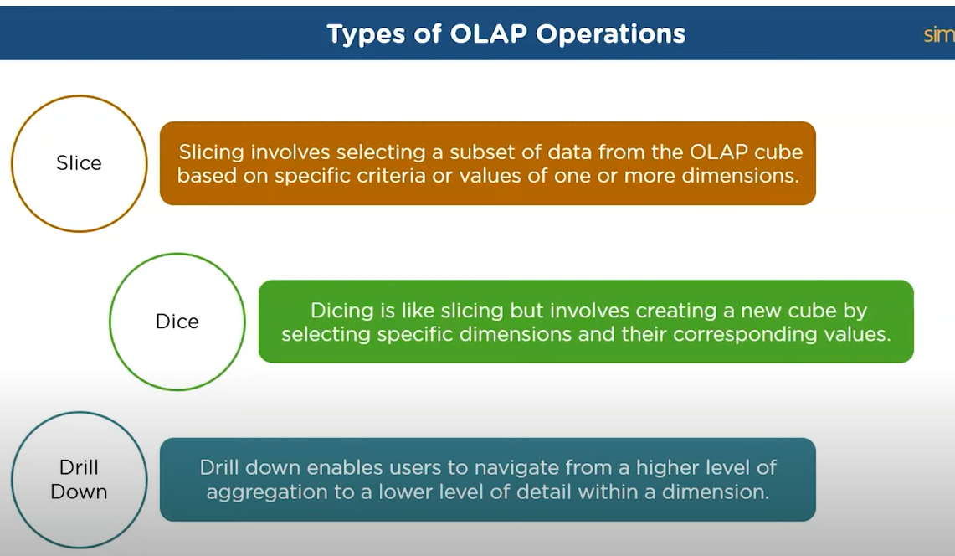
OPERATIONS

Slide 73
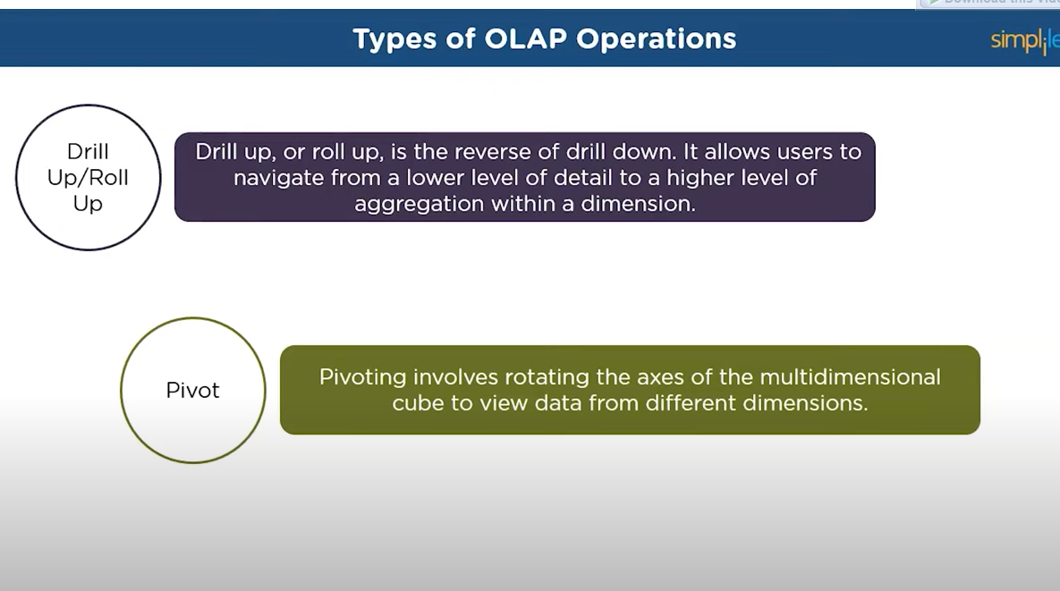

Slide 74
OLAP Operations
Slice – a subset of a multidimensional array
Dice – a slice on more than two dimensions
Drill Down/Up – navigating among levels of data ranging from the most summarized (up) to the most detailed (down)
Roll Up – computing all of the data relationships for one or more dimensions
Pivot – used to change the dimensional orientation of a report or an ad hoc query-page display

Slide 75
OLAP
Slicing Operations on a Simple Tree-Dimensional
Data Cube

Slide 76
Variations of OLAP
Multidimensional OLAP (MOLAP)
OLAP implemented via a specialized multidimensional database (or data store) that summarizes transactions into multidimensional views ahead of time
Relational OLAP (ROLAP)
The implementation of an OLAP database on top of an existing relational database
Database OLAP and Web OLAP (DOLAP and WOLAP); Desktop OLAP,…

Slide 77
DIFFERENCES
ROLAP | MOLAP | HOLAP
ROLAP stands for Relational Online Analytical Processing. | MOLAP stands for Multidimensional Online Analytical Processing. | HOLAP stands for Hybrid Online Analytical Processing.
The ROLAP storage mode causes the aggregation of the division to be stored in indexed views in the relational database that was specified in the partition's data source. | The MOLAP storage mode principle the aggregations of the division and a copy of its source information to be saved in a multidimensional operation in analysis services when the separation is processed. | The HOLAP storage mode connects attributes of both MOLAP and ROLAP. Like MOLAP, HOLAP causes the aggregation of the division to be stored in a multidimensional operation in an SQL Server analysis services instance.
ROLAP does not because a copy of the source information to be stored in the Analysis services data folders. Instead, when the outcome cannot be derived from the query cache, the indexed views in the record source are accessed to answer queries. | This MOLAP operation is highly optimize to maximize query performance. The storage area can be on the computer where the partition is described or on another computer running Analysis services. Because a copy of the source information resides in the multidimensional operation, queries can be resolved without accessing the partition's source record. | HOLAP does not causes a copy of the source information to be stored. For queries that access the only summary record in the aggregations of a division, HOLAP is the equivalent of MOLAP.
Query response is frequently slower with ROLAP storage than with the MOLAP or HOLAP storage mode. Processing time is also frequently slower with ROLAP. | Query response times can be reduced substantially by using aggregations. The record in the partition's MOLAP operation is only as current as of the most recent processing of the separation. | Queries that access source record for example, if we want to drill down to an atomic cube cell for which there is no aggregation information must retrieve data from the relational database and will not be as fast as they would be if the source information were stored in the MOLAP architecture.

Slide 78
ETL (Extract, Transform, and Load) Process
The mechanism of extracting information from source systems and bringing it into the data warehouse is commonly called ETL, which stands for Extraction, Transformation and Loading.
The ETL process requires active inputs from various stakeholders, including developers, analysts, testers, top executives and is technically challenging.
To maintain its value as a tool for decision-makers, Data warehouse technique needs to change with business changes. ETL is a recurring method (daily, weekly, monthly) of a Data warehouse system and needs to be agile, automated, and well documented.

Slide 79
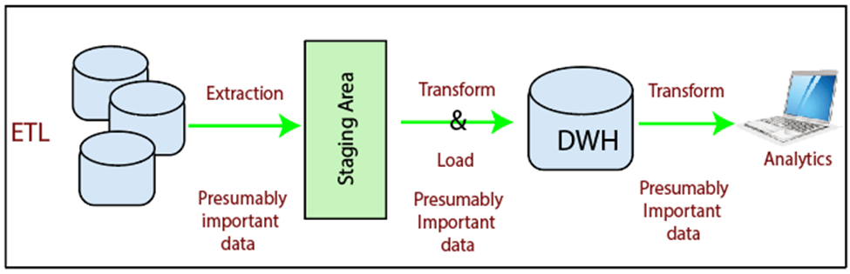

Slide 80
ETL
Extraction is the operation of extracting information from a source system for further use in a data warehouse environment. This is the first stage of the ETL process.
Extraction process is often one of the most time-consuming tasks in the ETL.
The source systems might be complicated and poorly documented, and thus determining which data needs to be extracted can be difficult.
The data has to be extracted several times in a periodic manner to supply all changed data to the warehouse and keep it up-to-date.

Slide 81
Cleansing
Cleansing
The cleansing stage is crucial in a data warehouse technique because it is supposed to improve data quality. The primary data cleansing features found in ETL tools are rectification and homogenization. They use specific dictionaries to rectify typing mistakes and to recognize synonyms, as well as rule-based cleansing to enforce domain-specific rules and defines appropriate associations between values.
The following examples show the essential of data cleaning:
If an enterprise wishes to contact its users or its suppliers, a complete, accurate and up-to-date list of contact addresses, email addresses and telephone numbers must be available.
If a client or supplier calls, the staff responding should be quickly able to find the person in the enterprise database, but this need that the caller's name or his/her company name is listed in the database.
If a user appears in the databases with two or more slightly different names or different account numbers, it becomes difficult to update the customer's information.
Transformation
Transformation is the core of the reconciliation phase. It converts records from its operational source format into a particular data warehouse format. If we implement a three-layer architecture, this phase outputs our reconciled data layer.

Slide 82
Transformation
Transformation
Transformation is the core of the reconciliation phase. It converts records from its operational source format into a particular data warehouse format. If we implement a three-layer architecture, this phase outputs our reconciled data layer.

Slide 83
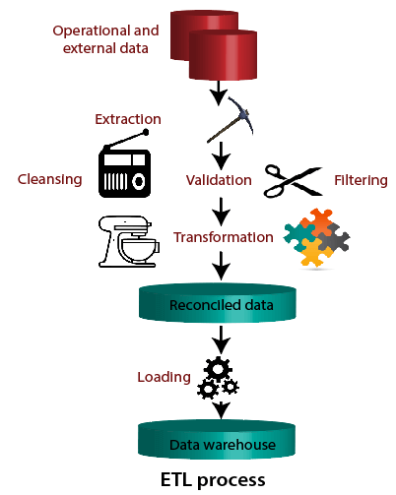
ETL

Slide 84
ETL
Loading
The Load is the process of writing the data into the target database. During the load step, it is necessary to ensure that the load is performed correctly and with as little resources as possible.
Loading can be carried in two ways:
Refresh: Data Warehouse data is completely rewritten. This means that older file is replaced. Refresh is usually used in combination with static extraction to populate a data warehouse initially.
Update: Only those changes applied to source information are added to the Data Warehouse. An update is typically carried out without deleting or modifying preexisting data. This method is used in combination with incremental extraction to update data warehouses regularly

Slide 85
Star Schema
What is Star Schema?
A star schema is the elementary form of a dimensional model, in which data are organized into facts and dimensions. A fact is an event that is counted or measured, such as a sale or log in. A dimension includes reference data about the fact, such as date, item, or customer.
A star schema is a relational schema where a relational schema whose design represents a multidimensional data model. The star schema is the explicit data warehouse schema. It is known as star schema because the entity-relationship diagram of this schemas simulates a star, with points, diverge from a central table. The center of the schema consists of a large fact table, and the points of the star are the dimension tables.

Slide 86
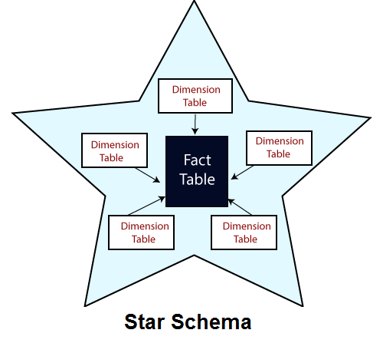
STAR SCHEMA

Slide 87
Fact Tables
Fact Tables
A table in a star schema which contains facts and connected to dimensions. A fact table has two types of columns: those that include fact and those that are foreign keys to the dimension table. The primary key of the fact tables is generally a composite key that is made up of all of its foreign keys.
A fact table might involve either detail level fact or fact that have been aggregated (fact tables that include aggregated fact are often instead called summary tables). A fact table generally contains facts with the same level of aggregation.

Slide 88
What is Snowflake Schema?
What is Snowflake Schema?
A snowflake schema is equivalent to the star schema. "A schema is known as a snowflake if one or more dimension tables do not connect directly to the fact table but must join through other dimension tables."
The snowflake schema is an expansion of the star schema where each point of the star explodes into more points. It is called snowflake schema because the diagram of snowflake schema resembles a snowflake. Snowflaking is a method of normalizing the dimension tables in a STAR schemas. When we normalize all the dimension tables entirely, the resultant structure resembles a snowflake with the fact table in the middle.
Snowflaking is used to develop the performance of specific queries. The schema is diagramed with each fact surrounded by its associated dimensions, and those dimensions are related to other dimensions, branching out into a snowflake pattern.
The snowflake schema consists of one fact table which is linked to many dimension tables, which can be linked to other dimension tables through a many-to-one relationship. Tables in a snowflake schema are generally normalized to the third normal form. Each dimension table performs exactly one level in a hierarchy.

Slide 89
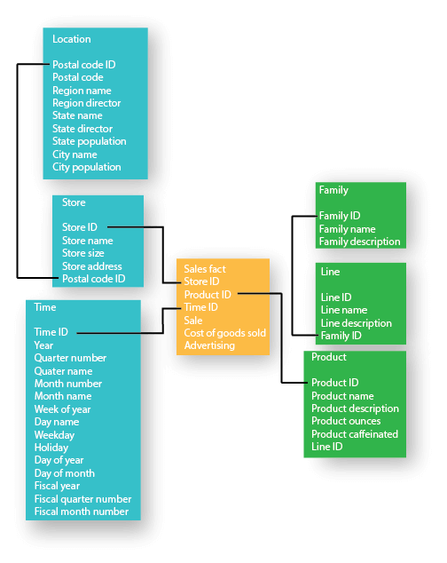

Slide 90
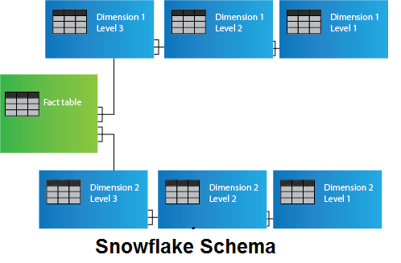
SCHEMA

Slide 91
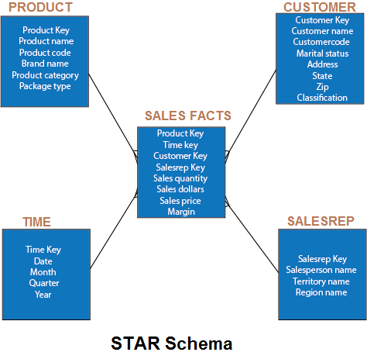
STAR SCHEMA

Slide 92

SNOWFLAKE SCHEMA

Slide 93
What is Fact Constellation Schema?
A Fact constellation means two or more fact tables sharing one or more dimensions. It is also called Galaxy schema.
Fact Constellation Schema describes a logical structure of data warehouse or data mart. Fact Constellation Schema can design with a collection of de-normalized FACT, Shared, and Conformed Dimension tables.

Slide 94

FACT

Slide 95

FACT

Slide 96
DW Implementation Issues
11 tasks for successful DW implementation
Establishment of service-level agreements and data-refresh requirements
Identification of data sources and their governance policies
Data quality planning
Data model design
ETL tool selection
Relational database software and platform selection
Data transport
Data conversion
Reconciliation process
Purge and archive planning
End-user support

Slide 97
Difficulties of Implementing Data Warehouses
Data Integration:
Data Quality:
Data Volume
Performance
Security:
Business Requirements
Cost:
Change management

Slide 98
Advantages:
Improved Data Quality:
Better Decision-Making
Historical Analysis
Scalability
Supports Self-Service Analytics:
Disadvantages:
Time and Cost
Complexity
Data Silos:
Performance:
Data Governance:

Slide 99
Data warehouse projects have many risks
Starting with the wrong sponsorship chain.
Setting expectations that you cannot meet
Engaging politically naive behaviour
Loading the data warehouse with information just because it is available.
Believing that data warehousing database design is the same as transactional database
design.
Choosing a data warehouse manager who is technology oriented rather than user oriented.

Slide 100
DW Implementation Guidelines
Project must fit with corporate strategy & business objectives
There must be complete buy-in to the project by executives, managers, and users
It is important to manage user expectations about the completed project
The data warehouse must be built incrementally
Build in adaptability, flexibility and scalability
The project must be managed by both IT and business professionals
Only load data that have been cleansed and are of a quality understood by the organization
Do not overlook training requirements
Be politically aware

Slide 101
Successful DW Implementation Things to Avoid
Starting with the wrong sponsorship chain
Setting expectations that you cannot meet
Engaging in politically naive behavior
Loading the data warehouse with information just because it is available
Believing that data warehousing database design is the same as transactional database design
Choosing a data warehouse manager who is technology oriented rather than user oriented

Slide 102
Real Time Data Warehouse

Slide 103
Real Time Data Warehouse

Slide 104
Trends in data warehousing

Slide 106
Successful DW Implementation Things to Avoid - Cont.
Focusing on traditional internal record-oriented data and ignoring the value of external data and of text, images, etc.
Delivering data with confusing definitions
Believing promises of performance, capacity, and scalability
Believing that your problems are over when the data warehouse is up and running
Focusing on ad hoc data mining and periodic reporting instead of alerts

Slide 107
Failure Factors in DW Projects
Lack of executive sponsorship
Unclear business objectives
Cultural issues being ignored
Change management
Unrealistic expectations
Inappropriate architecture
Low data quality / missing information
Loading data just because it is available

Slide 108
Massive DW and Scalability
Scalability
The main issues pertaining to scalability:
The amount of data in the warehouse
How quickly the warehouse is expected to grow
The number of concurrent users
The complexity of user queries
Good scalability means that queries and other data-access functions will grow linearly with the size of the warehouse

Slide 109
Real-time/Active DW/BI
Enabling real-time data updates for real-time analysis and real-time decision making is growing rapidly
Push vs. Pull (of data)
Concerns about real-time BI
Not all data should be updated continuously
Mismatch of reports generated minutes apart
May be cost prohibitive
May also be infeasible

Slide 110

Real-time/Active DW at Teradata

Slide 111

Enterprise Decision Evolution and DW

Slide 112
sas
SAS (Statistical Analysis Software) is a popular data analytics software that can manipulate, mine, organize, and retrieve data from a variety of sources, as well as do statistical analysis.
A chart (sometimes known as a graph) is a graphical representation for data visualization, in which "the data is represented by symbols, such as bars in a bar chart, lines in a line chart, or slices in a pie chart

Slide 113
Here are some key aspects of administering a data warehouse
:1.Performance Monitoring
2.Data Security and Access Control
3.Backup and Recovery
4.Schema Evolution and Maintenance
5.Capacity Planning and Scalability
6.User Support and Training
7.Collaboration with Stakeholders

Slide 114

Traditional vs Active DW Environment

Slide 115
DW Administration and Security
Data warehouse administrator (DWA)
DWA should…
have the knowledge of high-performance software, hardware and networking technologies.
possess solid business knowledge and insight.
be familiar with the decision-making processes so as to suitably design/maintain the data warehouse structure.
possess excellent communications skills.
Security and privacy is a pressing issue in DW
Safeguarding the most valuable assets
Government regulations (HIPAA, etc.)
Must be explicitly planned and executed

Slide 116
The Future of DW
Sourcing…
Open source software
SaaS (software as a service)
Cloud computing
DW appliances
Infrastructure…
Real-time DW
Data management practices/technologies
In-memory processing (“super-computing”)
New DBMS
Advanced analytics

Slide 117
Threats that Might Affect Data Warehousing
1. Unauthorized access
2. Theft
Hacking
Malware attacks

